Slide 1
Hospital IPD Analysis
Group project : Dab 103 - Analytics Tools & Decision Making

Slide 2










Team Introduction
Team 3-Section 004
Team members:
Divyajot Singh Gurjinderpal Singh Jashanpreet sharma
Khushbuben Patel

Slide 3
Background & Motivation
Healthcare organizations receives a huge amount of patient data each day. While this situation represents a challenge, it also offers organizations an opportunity to dramatically improve the quality of care and make better business decisions by leveraging more value and insights from their data.

Slide 4
Problem statement
Healthcare management are not able to analyse influx of patients in specifically in IPD of various departments due to which hospitals are not able to optimize their treatment plans to reduce LOS, to reduce infection rates among patients, staff, and visitors.
Also ,hospitals needs these insights to allocate budget and cut expenses.
Project Proposal
The goal of this project is to use descriptive Analytics to analyse the patient admission data for each patient and give Hospital group a better insight into the working of their hospitals , their revenue, required allocation of resources.

Slide 5
Analysis Questions
Analyzing various age groups having Severity of Illnesss.
Analyzing the number of patients being admitted in the hospital and their type of admissions in various bed grades
Distribution of patients in different hospitals based on type of admission
Analyzing the length of stay of patients in the hospital.
Revenue generated by hospitals

Slide 6
Dataset description
The Analysis will be based on the collected data set of patient hospitalization in different hospitals.
The dataset contains patient hospitalization records from 32 different hospitals and 5 different departments.
It describes the type of admission along with Severity of illness.
Hospitals are divided into different regions and dataset provide the length of stay for each patient.
In the dataset the variables are divided into two levels: Patient-Level and Hospital-Level.
Link to Dataset : Healthcare Patient Admission Dataset

Slide 7
Variable Description
Variables | Description
case_id | Case_ID registered in Hospital
Hospital_code | Unique code for the Hospital
Hospital_type_code | Unique code for the type of Hospital
City_Code_Hospital | City Code of the Hospital
Hospital_region_code | Region Code of the Hospital
Available Extra Rooms in Hospital | Number of Extra rooms available in the Hospital
Department | Department overlooking the case
Ward_Type | Department overlooking the case
Ward_Facility_Code | Code for the Ward Facility
Bed Grade | Code for the Ward Facility
patientid | Unique Patient Id
City_Code_Patient | City Code for the patient
Type of Admission | Admission Type registered by the Hospital
Severity of Illness | Severity of the illness recorded at the time of admission
Visitors with Patient | Number of Visitors with the patient
Age | Age of the patient
Admission_Deposit | Deposit at the time of Admission
Stay | Deposit at the time of Admission

Slide 8
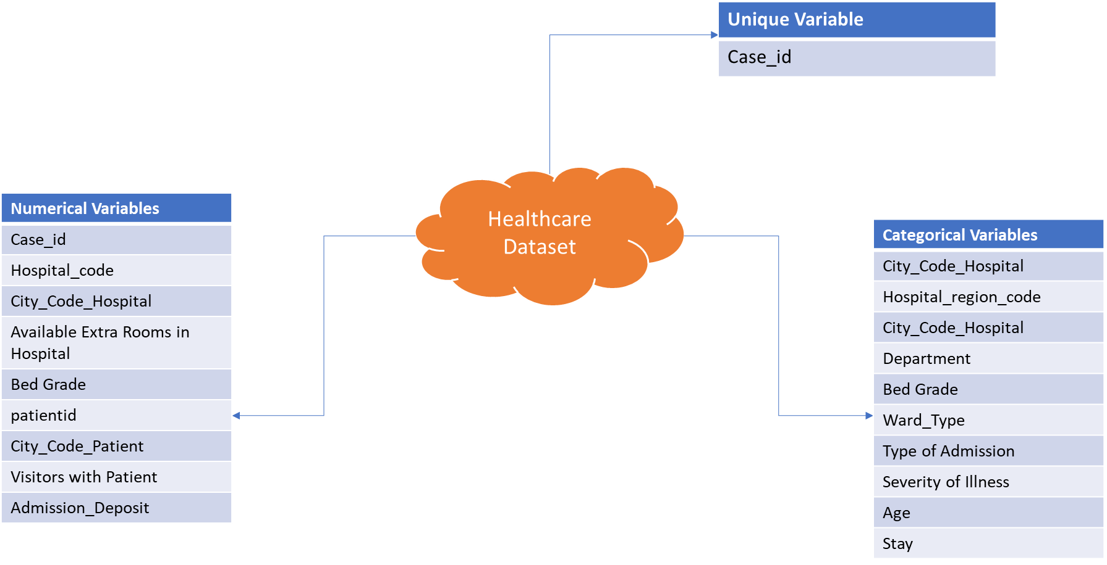
Variable Type

Slide 9
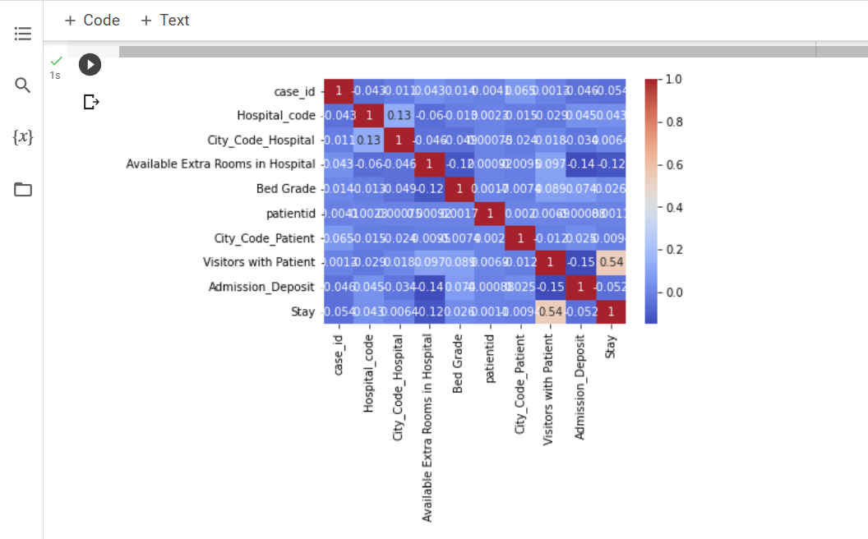
Visualizations of various features
Visualization to show the correlation of the dataset

Slide 10
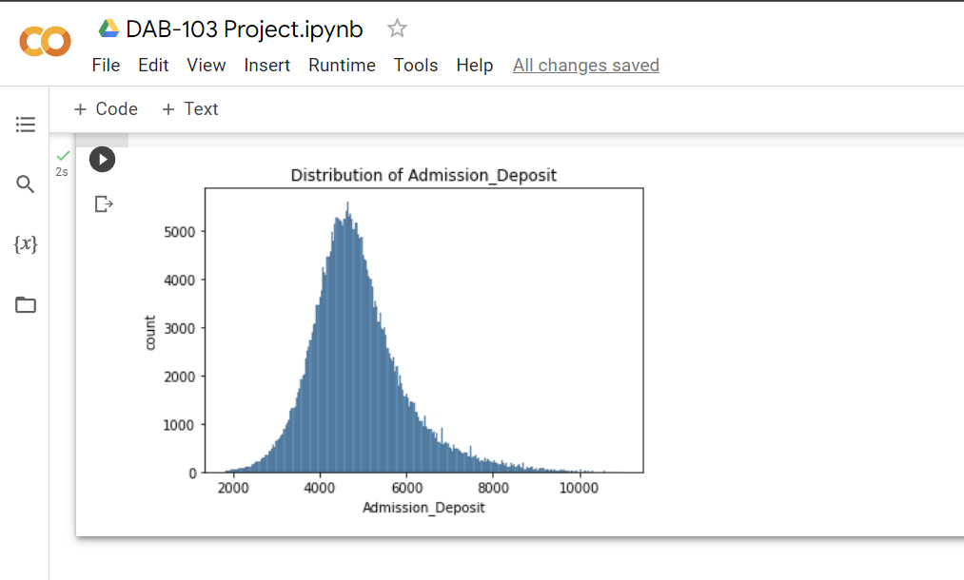
Plot to show the distribution of Admission Deposit

Slide 11
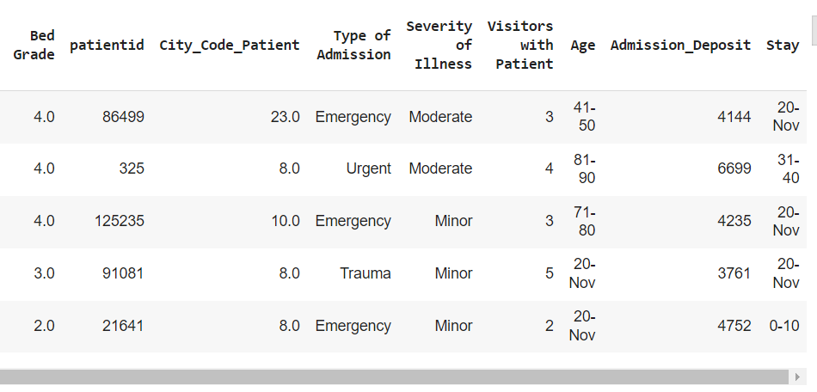
Data Cleaning & Transformation
Replaced Null values in City_Patient Code & Bed_Grade features using the Mod method.
dropped observation with Incorrect value [“20 Nov”] in Age parameter.
Renamed columns to eliminate whitespaces.
Replace the incorrect incorrect values in the Stay column:
Replace '20 Nov' with ‘0-10'
Replaced 'More than 100 days' with '100+’

Slide 12
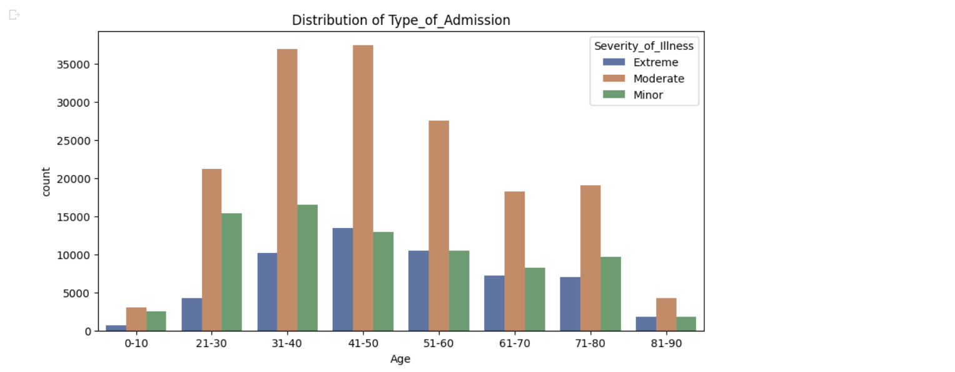
Data Visualization
Various age groups having Severity of Illnesss.
Age group of 41-50 has the highest level of "Extreme" severity of illness, followed by 31-40 and 51-60.
Patients aged 31-40 appear to have a higher incidence of "Minor" severity of illness
However, it's important to note that more information is needed to make definitive conclusions about the severity of illness among different age groups.

Slide 13
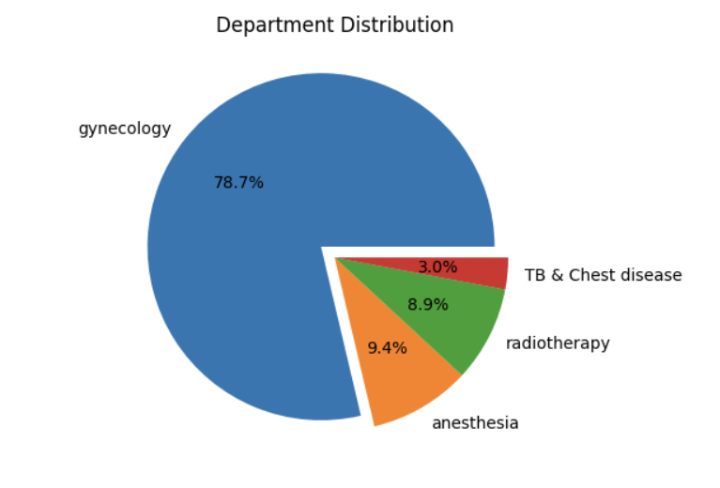
Proportions of patients on the basis of departments
Pie chart shows that "Gynecology" department has the highest number of patients. TB & Chest Disease has the lowest number of patients.

Slide 14
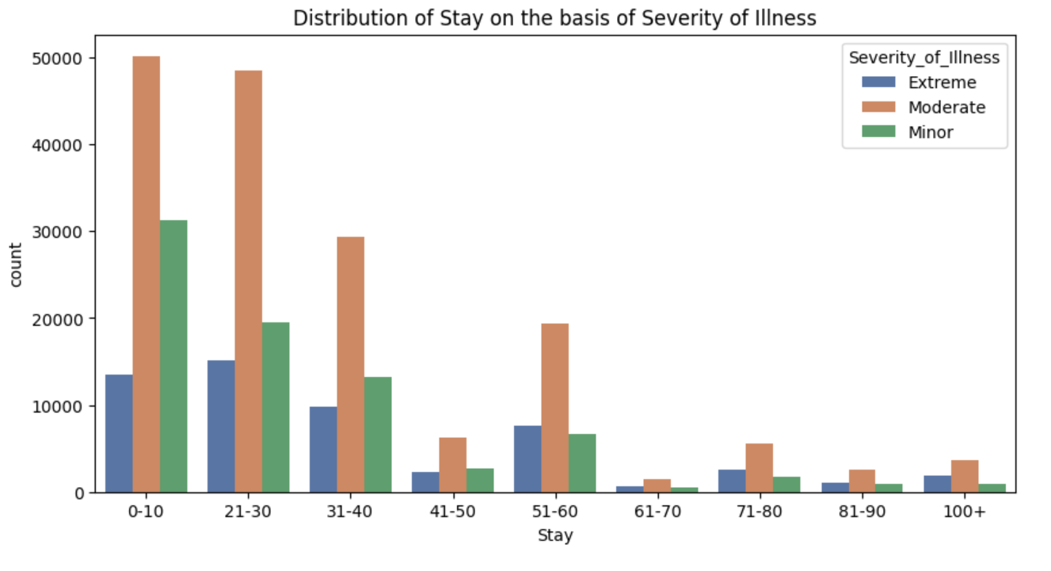
Analyzing the length of stay of patients in the hospital.
Highest number of Patients with “Moderate” severity stayed for almost 25 days in the hospital.
Patients with “Minor” severity are the lowest followed by ”Extreme” severity.

Slide 15
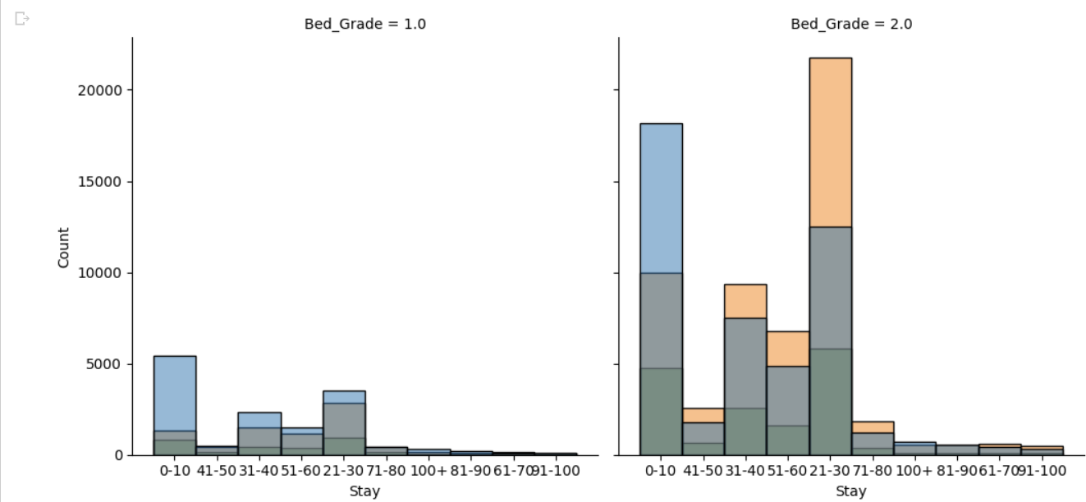
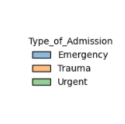
Bed Grade vs Type Of Admission
Most Emergency patients with Bed Grade-1.0 stayed for almost 10 days in the hospital.
Majority of the trauma patients with bed grade-2.0 stayed for 21 to 30 days in the hospital.

Slide 16
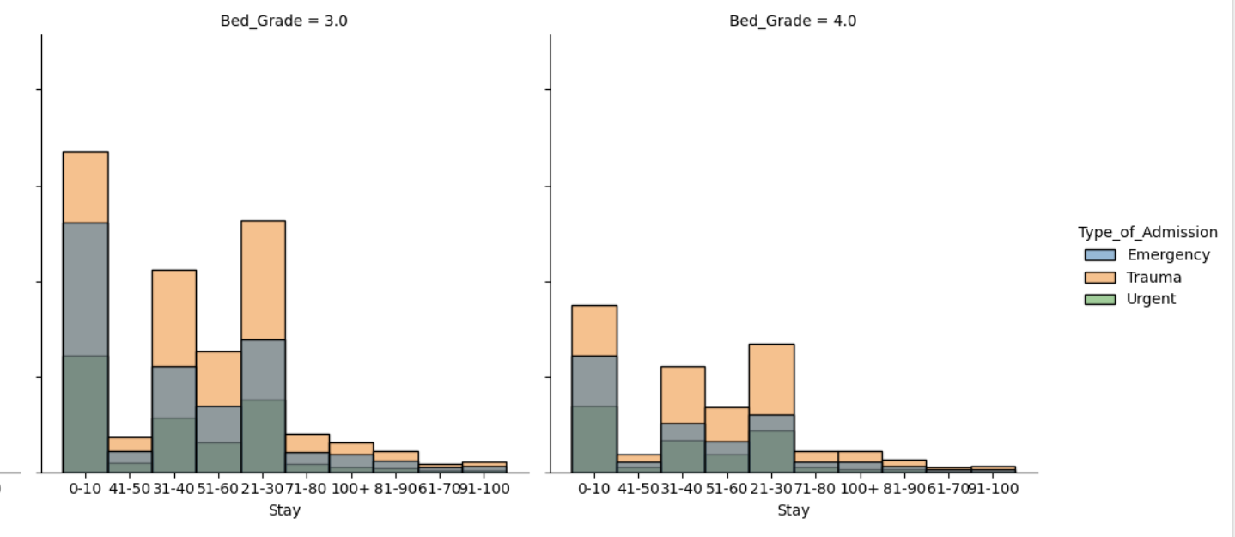

Slide 17
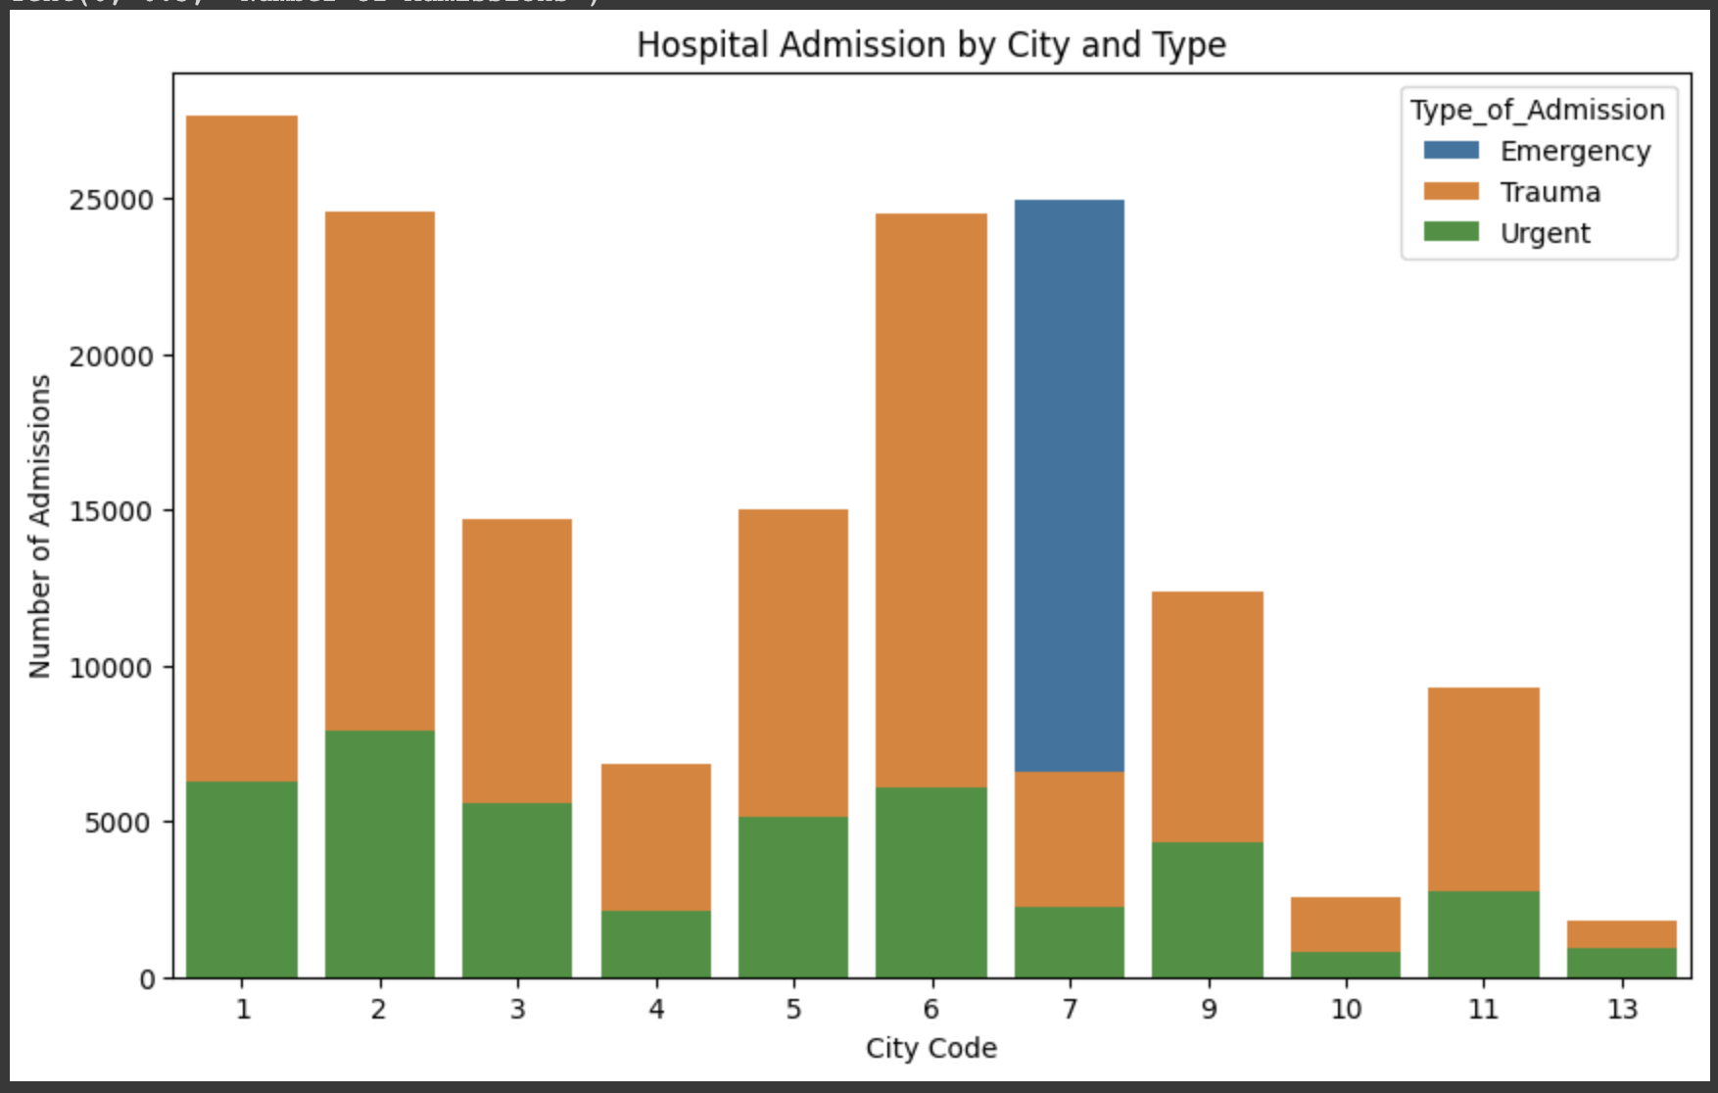
Patient count in each city Hospital.

Slide 18
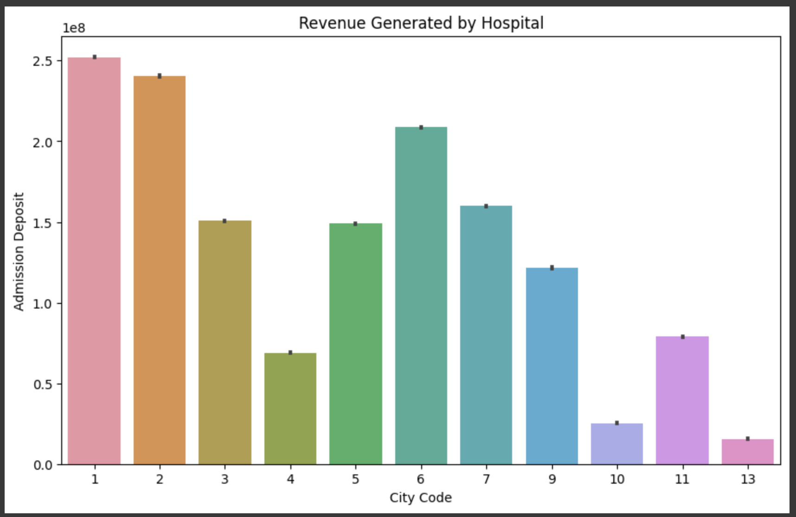
Revenue generated by various city hospitals

Slide 19

RECOMMENDATIONS
Focus on providing patient-centered care by actively involving patients in decision-making processes, addressing their concerns, and tailoring treatment plans to meet their individual needs. Implement patient satisfaction surveys to gather feedback and make improvements accordingly.
By utilizing data efficiently hospital can allocate resources and staff members based on patient needs. Moreover, analyzing outcomes of checkups among different demographic groups to identify factors that may prevent individuals from seeking treatment and improving healthcare accessibility.
Implement systems that analyze patient data in real-time, providing immediate recommendations to healthcare professionals during prescriptive decision-making. This will enhance patient safety, optimizes treatment plans, and reduces unnecessary in-house procedures.
Hospitals can leverage data analytics to offer accurate and proactive preventive care. Analyze patient data, including drug type, conditions, and duration of visits, to identify high-risk individuals and develop personalized interventions, ultimately reducing hospital admissions.

Slide 20
Conclusion:
Most of the admitted patients were from the city code 4,6 and 8.
Gynecology department was having the highest number of patients among all the departments.
Hospital 10&13 need to increase revenue and their patient counts.
31 to 50 was the age with highest number of moderate and extreme level of illness.
The average stay was between 0 to 30 days.

Slide 21
Appendix

Slide 22
EDA – identifying null and incomplete values
Dataset Loaded to Colab Workspace.
Dataset contains approx 300k observations & 18 variables
Total 4645 null values :city code Patient – 4532, bed_grade – 113.
Dataset contains 4645 rows with incomplete values.
Pateint data can be grouped into:
Hospital city Area
Department and Type of admission
Length of stay and severity of illness
Features correlation: stay & Visitors_with_Patient : 0.54
city_code_hospital & hospital_code : 0.13
Admission_deposit & Available extra rooms in hospital : -0.14

Slide 23
References:
Github Repository - https://github.com/divyajot98/HEALTHCARE-ANALYTICS-PROJECT
Visualizations Examples- https://lms.stclaircollege.ca/bbcswebdav/pid-2750050-dt-content-rid-37514164_1/xid-37514164_1
Pandas reference documentation- https://pandas.pydata.org/docs/
Matplotlib Cheatsheet - https://matplotlib.org/cheatsheets/

